Slide 1
1 Malaysia Cuisine Ordering System SteadyAlphaQ
GROUP: T127
MEMBERS | STUDENT ID
ONG CHEE THONG | 1191101108
NICHOLAS WEE LIK KEN | 1191100997
RESHMAHDEVI A/P JANARTHANAN NAMBIAR | 1191100192
NG YEE HAO | 1191100354
NG ZHAN HENG | 1191101024

Slide 2
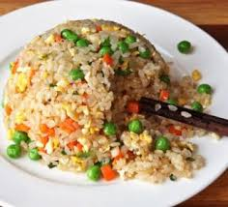
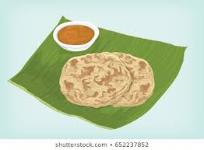
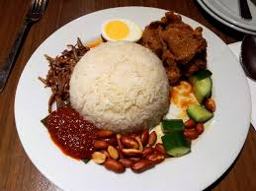
INTRODUCTION
‘1 Malaysia Ordering System’
It is fully 100% Halal, no pork, no beef and no alcohol

Slide 3

Usage of…..
Sequence
Loop
Selection

Slide 4
Objective

Slide 5


Help customers to order food.
Help restaurant operators to serve customers.

Slide 6

Help restaurant workers to be more organized.

Slide 7
Conclusion

Slide 8

Things that we learnt from the project.

Slide 9


Teamwork
Coding

Slide 10

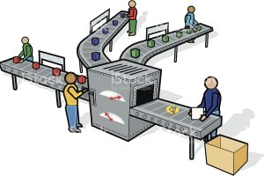
Effective Discussion
Job Division

Slide 11
Future Ideas

Slide 12

Internet Of Things

Slide 13


Slide 14

Demonstration

